Slide 1

Code overview: stoch3_ros

Slide 2
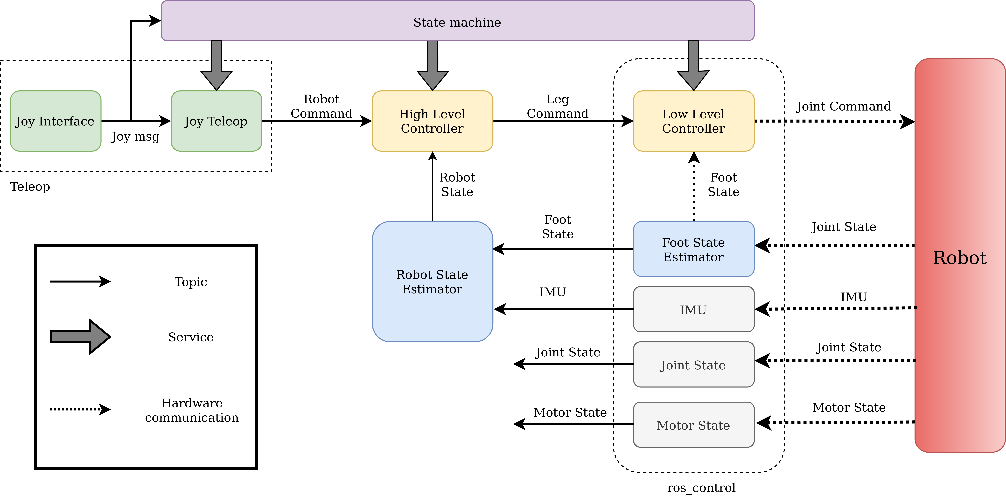
Software Architecture

Slide 3
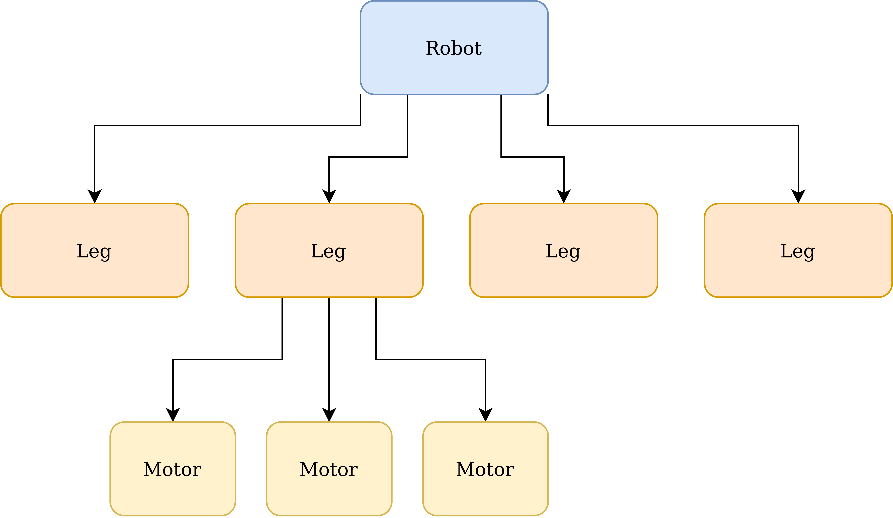
Physical Abstraction

Slide 4
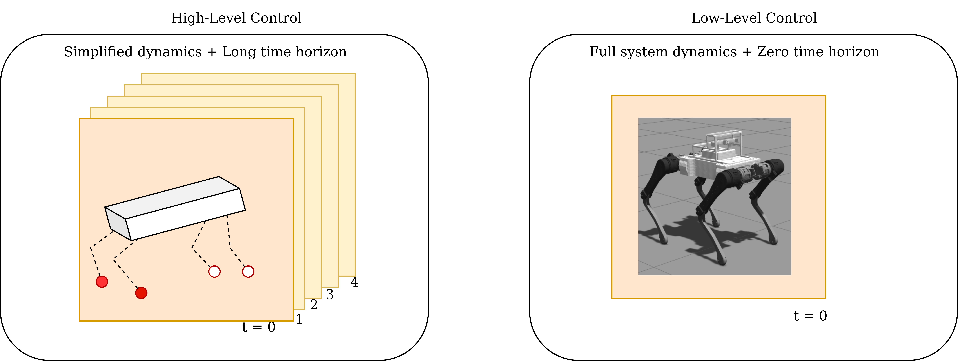
Temporal Abstraction

Slide 5
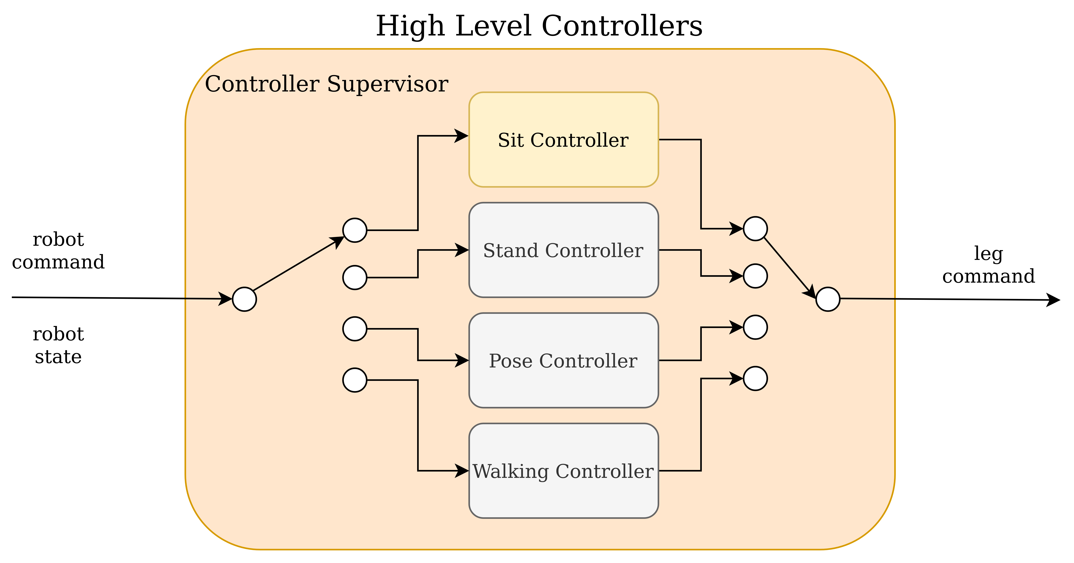
High-level Controllers
Multiple controllers (behaviours)
Mutually exclusive
Seamless transition required
Same input/output interface
Same operating frequency

Slide 6
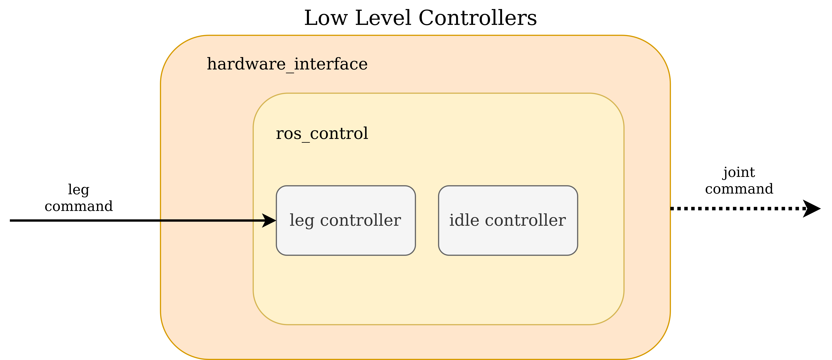
Low-level Controllers
Multiple controllers
Some mutually exclusive
Simultaneous execution
Same operating frequency
Same controllers used in simulation and on real hardware

Slide 7
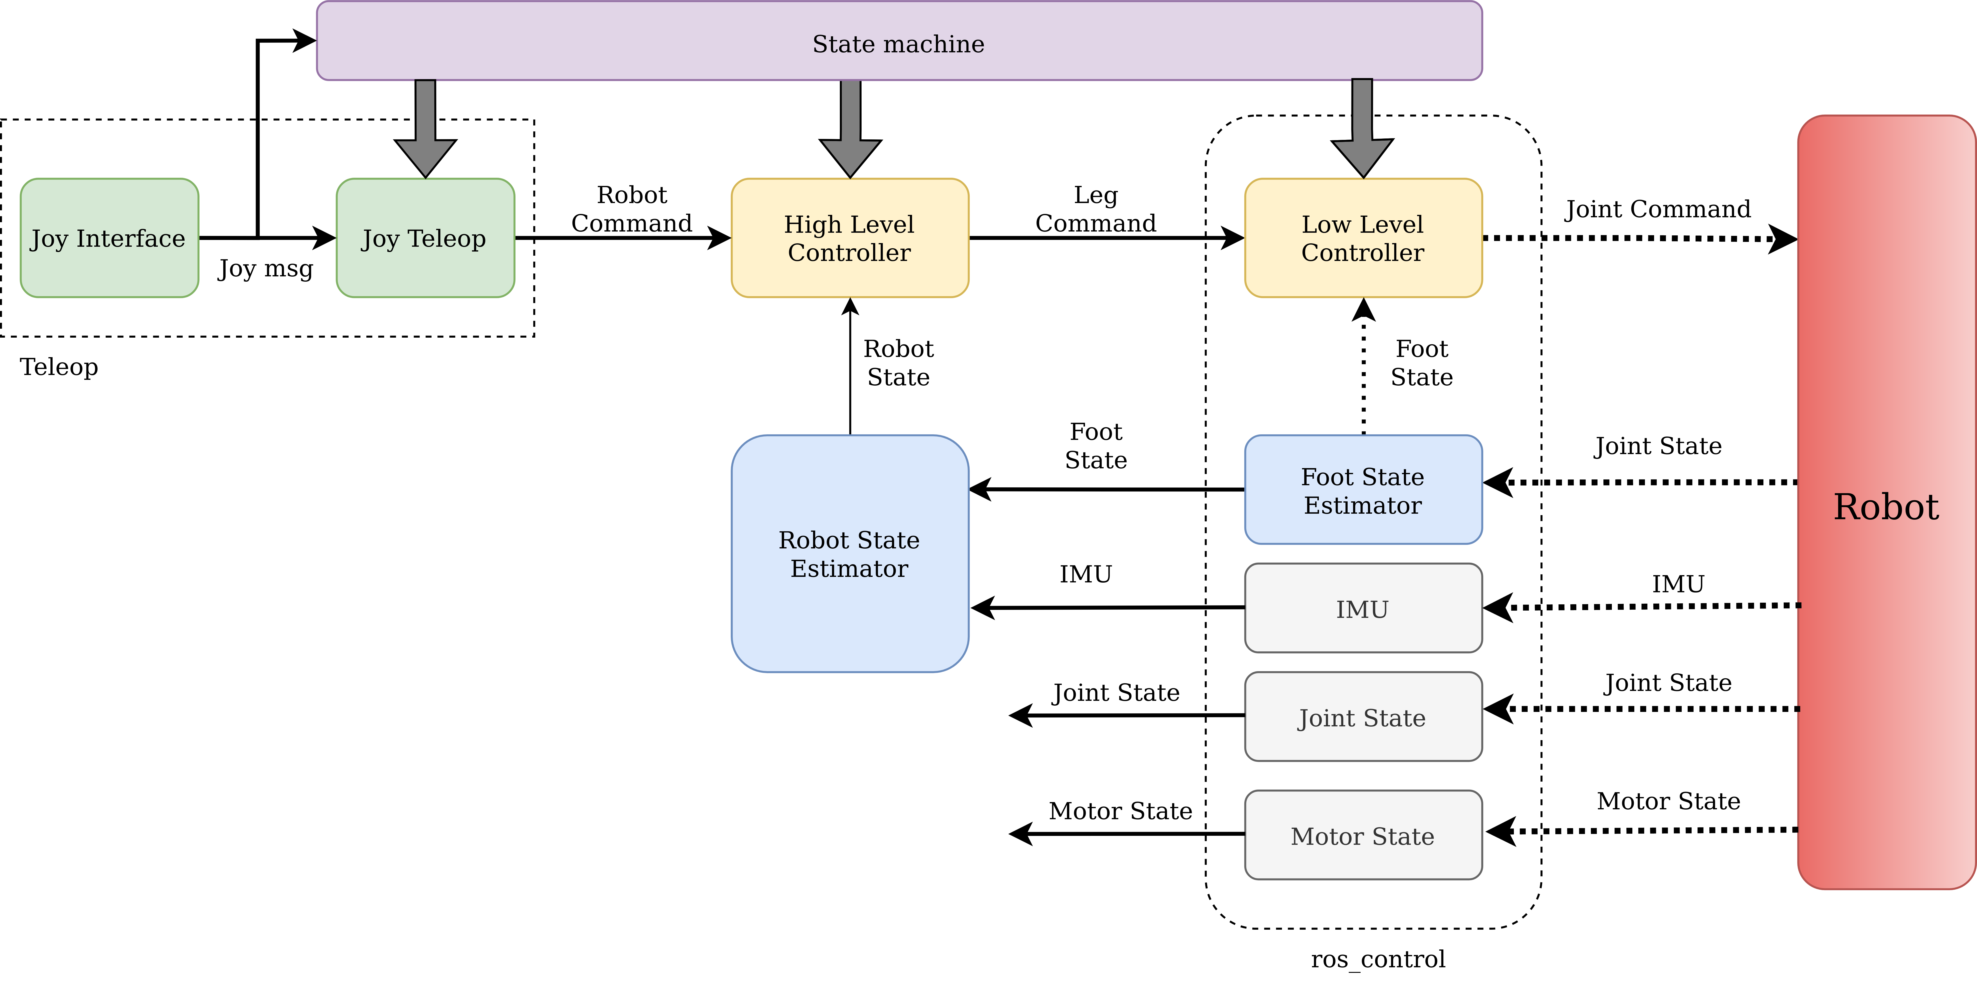
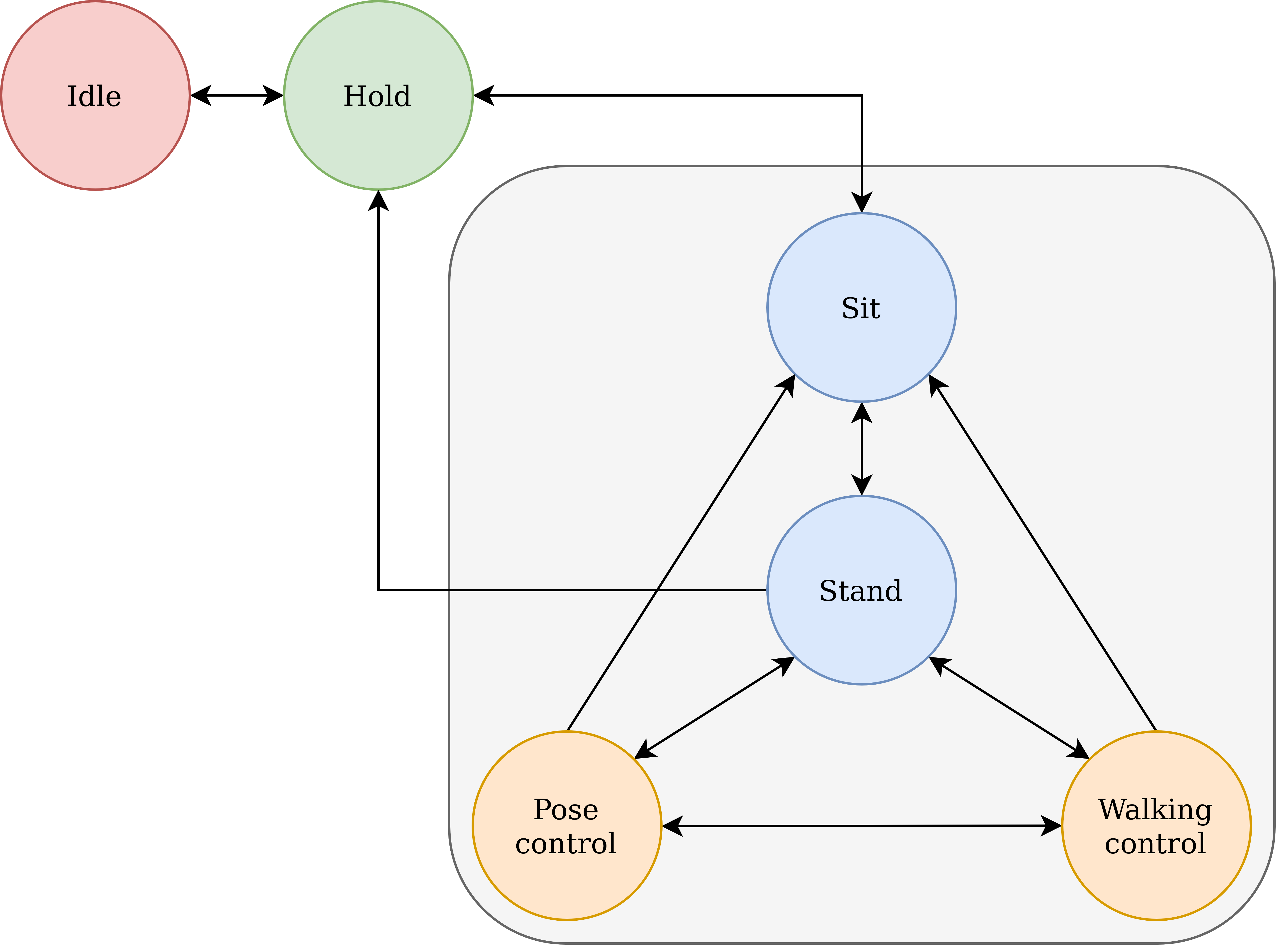
State machine
Helps manage different behaviours (sit, stand, walk etc.)
Each behaviour is a robot state
Also, maintains system state

Slide 8
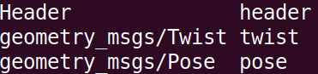
Robot Command
stoch3_msgs/RobotCommand

Slide 9
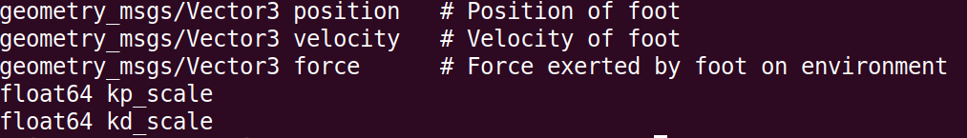
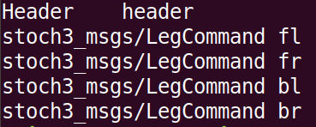
Leg Command
stoch3_msgs/LegCommand
stoch3_msgs/QuadrupedLegCommand

Slide 10
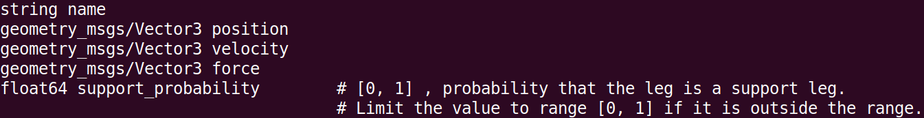
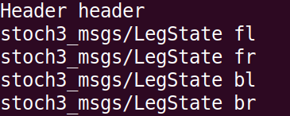
Leg State
stoch3_msgs/LegState
stoch3_msgs/QuadrupedLegState

Slide 11
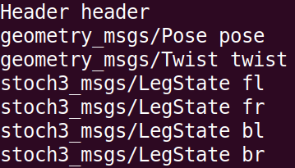
Robot State
stoch3_msgs/QuadrupedRobotState

